Slide 1
Knowledge Integration
Natural Language Processing
(based on revision of Megan Leszczynski Lectures)

Slide 2
Announcement
TA announcements (if any)...

Slide 3
Suggested Readings
ERNIE: Enhanced Language Representation with Informative Entities
Barack’s Wife Hillary: Using Knowledge Graphs for Fact-Aware Language Modeling
Pretrained Encyclopedia: Weakly Supervised Knowledge-Pretrained Language Model
Language Models as Knowledge Bases?

Slide 4
Motivation

Slide 5
Recap: LMs
Standard language models (LM) predict the next word in a sequence of text and can compute the probability of a sequence
The students opened their books.
Recently, masked language models (MLM) (e.g., BERT) instead predict a masked token which enables bidirectional context learning
The [MASK] opened their [MASK].
Both are great for training over large amounts of unlabeled text!

Slide 6
Recap: LMs
Traditionally, LMs are used for many tasks involving generating or evaluating the probability of text:
Summarization
Dialogue
Autocompletion
Machine translation
Fluency evaluation
…
Today, LMs are commonly used to generate pretrained representations of text that encode some notion of language understanding for downstream NLP tasks
Can a language model be used as a knowledge base?

Slide 7
What does a LM know?
iPod Touch is produced by Apple .
London Jazz Festival is located in London .
Dani Alves plays with Santos .
Carl III used to communicate in German .
Ravens can fly.
Examples taken from Petroni et al., EMNLP 2019 to test BERT-Large
Language Models as Knowledge Bases? Petroni et al., 2019, https://aclanthology.org/D19-1250.pdf

Slide 8
What does a LM know?
Predictions generally make sense (e.g. the correct types), but are not all factually correct.
Why might this happen?
Unseen facts: some facts may not have occurred in the training corpora at all
Rare facts: LM hasn’t seen enough examples during training to memorize the fact
Model sensitivity: LM may have seen the fact during training, but is sensitive to the phrasing of the prompt
Correctly answers “x was made in y” templates but not “x was created in y”
The inability to reliably recall knowledge is a key challenge facing LMs today!
Recent works have found LMs can recover some knowledge, but have a way to go.

Slide 9
The importance of knowledge
LM pretrained representations can benefit downstream tasks that leverage knowledge
For instance, extracting the relations between two entities in a sentence is easier with some knowledge of the entities (i.e., entity relation tasks)
Stretch goal: can LMs ultimately replace traditional knowledge bases?
Instead of querying a knowledge base for a fact (e.g. with SQL), query the LM with a natural language prompt!

Slide 10
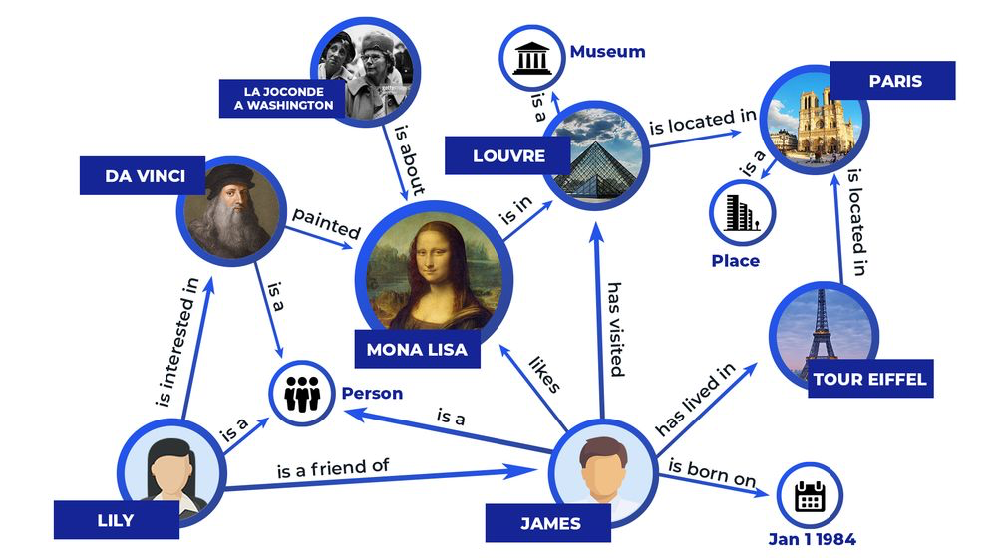
Knowledge graph as knowledge bases
A knowledge consists of head entity, tail entity and the relations, creating what we called the knowledge triples, e.g., James (head), January 1,1984 (tail), date of birth (relations)
Image source: https://community.atlassian.com/t5/Confluence-questions/Knowledge-graph/qaq-p/1565284

Slide 11
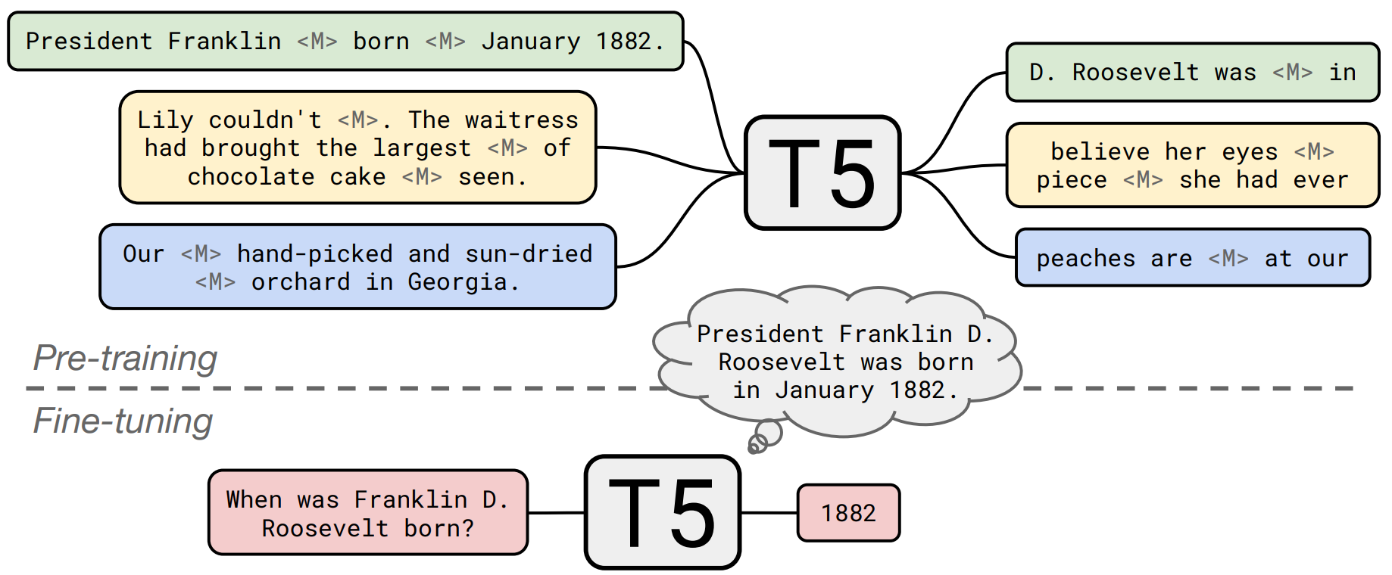
LM as knowledge bases

Slide 12
LM vs. traditional KBs
LMs are pretrained over large amounts of unstructured and unlabeled text
KBs require manual annotation or complex NLP pipelines to populate
LMs support more flexible natural language queries
Example: What does the final F in the song U.F.O.F. stand for?
Traditional KB wouldn’t have a field for “final F”; LM may learn this
However, there are also many open challenges to using LMs as KBs:
Hard to interpret (i.e., why does the LM produce an answer)
Hard to trust (i.e., the LM may produce a realistic, incorrect answer)
Hard to modify (i.e., not easy to remove or update knowledge in the LM)

Slide 13
Knowledge Integration Techniques

Slide 14
Knowledge Integration Techniques
Add pretrained entity embeddings
Idea: combine the embeddings of the entity
ERNIE
KnowBERT
Use an external memory
Idea: use external KBs for helping the prediction
KGLM
kNN-LM
Modify the training data
Idea: modify training objective to better learn knowledge
WKLM
ERNIE (not the same as above), salient span masking

Slide 15
Method 1: Add pretrained entity embeddings
Facts about the world are usually in terms of entities
Example: Washington was the first president of the United States.
Pretrained word embeddings do not have a notion of entities
For example, different word embeddings for “U.S.A.”, “United States of America” and “America” even though these refer to the same entity
What if we assign an embedding per entity?
Single entity embedding for “U.S.A.”, “United States of America” and “America”

Slide 16
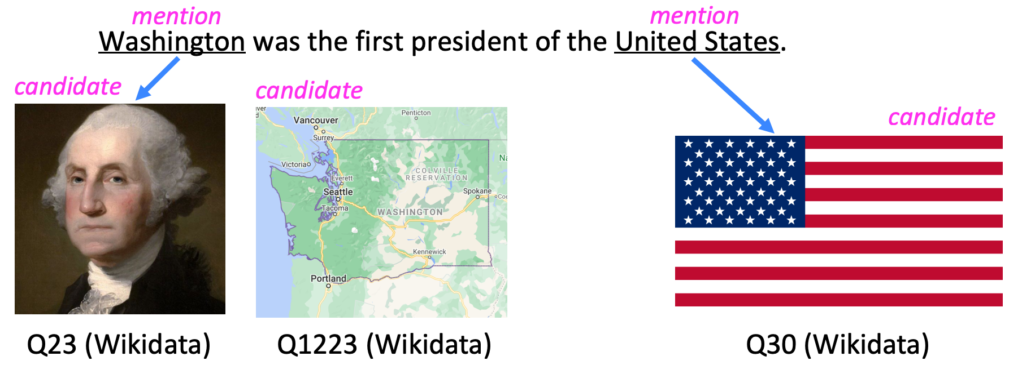
Method 1: Add pretrained entity embeddings
Entity embeddings can be useful to LMs iff you can do entity linking well!
Bootleg: Chasing the Tail with Self-Supervised Named Entity Disambiguation, Orr et al. 2021, http://cidrdb.org/cidr2021/papers/cidr2021_paper13.pdf
Efficient One-Pass End-to-End Entity Linking for Questions, Li et al., 2020, https://arxiv.org/pdf/2010.02413.pdf

Slide 17
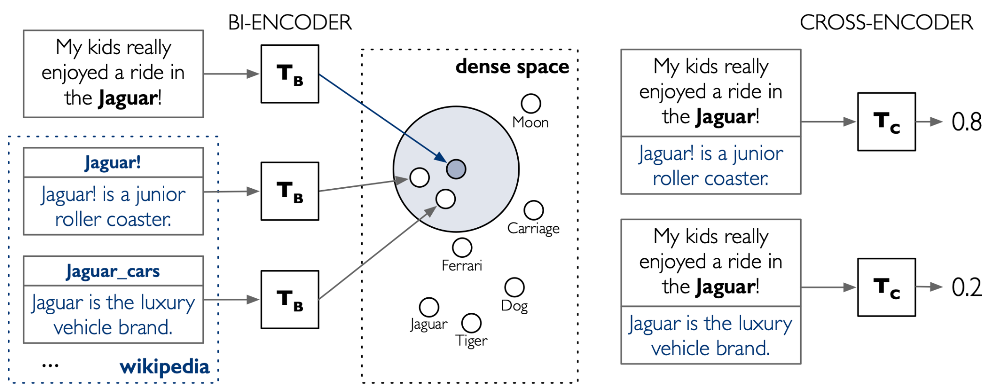
Method 1: Add pretrained entity embeddings
Entity embeddings are just like word embeddings, but for entities in a knowledge base
Many techniques for training entity embeddings:
TransE
Model is trained so that Subject + Relationships = Object
Wikipedia2Vec
Train just like the skipgram model, where model is trained to predict the connected entities given a entity
Transformer encodings of entity descriptions (e.g., BLINK)
Use two BERT encoders, one for encoding the independent entity embedding, and another encoder for linking the two entities
Translating Embeddings for Modeling Multi-relational Data, Bordes et al. 2013, https://papers.nips.cc/paper/2013/hash/1cecc7a77928ca8133fa24680a88d2f9-Abstract.html
Wikipedia2Vec: An Efficient Toolkit for Learning and Visualizing the Embeddings of Words and Entities from Wikipedia, Yamada et al. 2020, https://aclanthology.org/2020.emnlp-demos.4.pdf
Scalable Zero-shot Entity Linking with Dense Entity Retrieval, Wu et al., 2020, https://arxiv.org/pdf/1911.03814v3.pdf

Slide 18
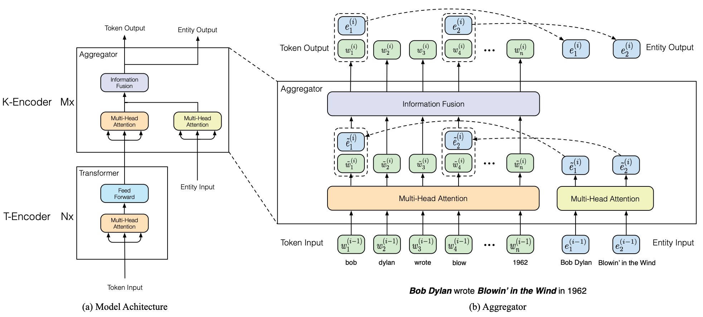
ERNIE: Enhanced Language Representation with Informative Entities [Zhang et al. 2019]
ERNIE: Enhanced Language Representation with Informative Entities, Zhang et al. 2019, https://arxiv.org/pdf/1905.07129.pdf

Slide 19
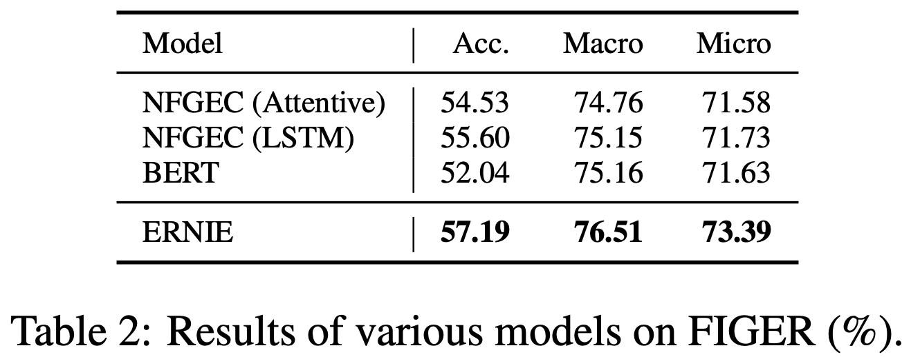
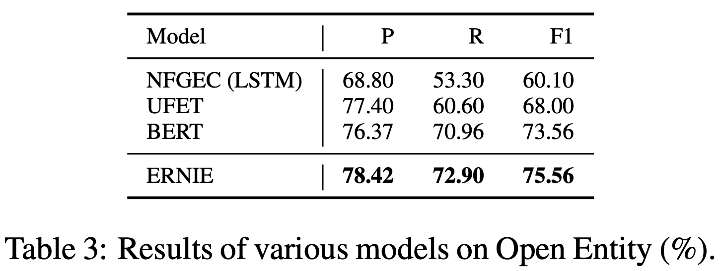
ERNIE: Enhanced Language Representation with Informative Entities
Performances on entity typing (using FIGER and Open Entity dataset)

Slide 20
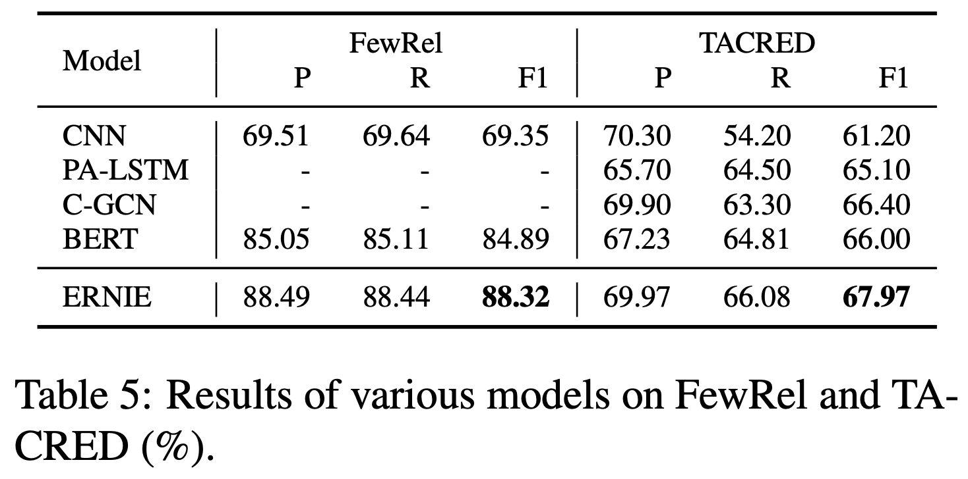
ERNIE: Enhanced Language Representation with Informative Entities
Performances on entity relations classification (using FewRel and TACRED dataset)

Slide 21
ERNIE: Enhanced Language Representation with Informative Entities
Strengths:
Combines entity + context info through fusion layers
Why not just concatenate?
Authors didn’t mention clearly why, but it could be the magnitude of the embeddings values interfering with…
Improves downstream knowledge-driven tasks
Limitations
Require text data with entities annotated as input, i.e., not really a end-to-end architecture

Slide 22
KnowBERT [Peters et al. 2019]
Key idea: pretrain an integrated entity linker (EL) as an extension to BERT
L_{knowBERT} = L_{NSP} + L_{MLM} + L_{EL}
On downstream tasks, EL predicts entities so entity annotations aren’t required
Hopefully, learning EL can better encode knowledge - shows performance gains over ERNIE on downstream tasks
Like ERNIE, knowBERT uses a fusion layer to combine entity and context information and adds a knowledge pretraining task
Knowledge Enhanced Contextual Word Representations, Peters et al. 2019, https://aclanthology.org/D19-1005.pdf

Slide 23
Method 2: Use an external memory
Previous methods rely on the pretrained entity embeddings to encode the factual knowledge from KBs for the language model.
Question: Are there more direct ways than pretrained entity embeddings to provide the model factual knowledge?
Answer: Yes! Give the model access to an external memory (a key-value store with access to KG triples or context information) and simply copy them when they are applicable
Advantages:
Can better support injecting and updating factual knowledge
Often without more pretraining!
More interpretable

Slide 24
KGLM [Logan et al., ACL 2019]
Ok, so in the case of predicting next words, can I just look up the knowledge graph for answer?
Yes, but it’s very computationally expensive!
Solution: Maintain a local knowledge graph
Idea: Run over the sequence. Build a local knowledge graph as you go. Train the model so that it is able to know whether is a (1) new entity, (2) relation to an existing entity, and (3) not an entity
If it is a new entity, look through the full knowledge graph and then find all the possible aliases and then determine the best answer
Add this information to a dynamically growing local graph
If it is a relation to an existing entity, look up the local knowledge graph, and see which relation makes most sense
If it is not an entity, simply do the usual distribution over all vocabularies
Barack’s Wife Hillary: Using Knowledge Graphs for Fact-Aware Language Modeling, Logan et al., 2019, https://aclanthology.org/P19-1598/

Slide 25
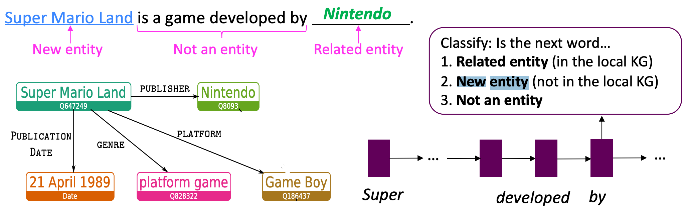
KGLM

Slide 26
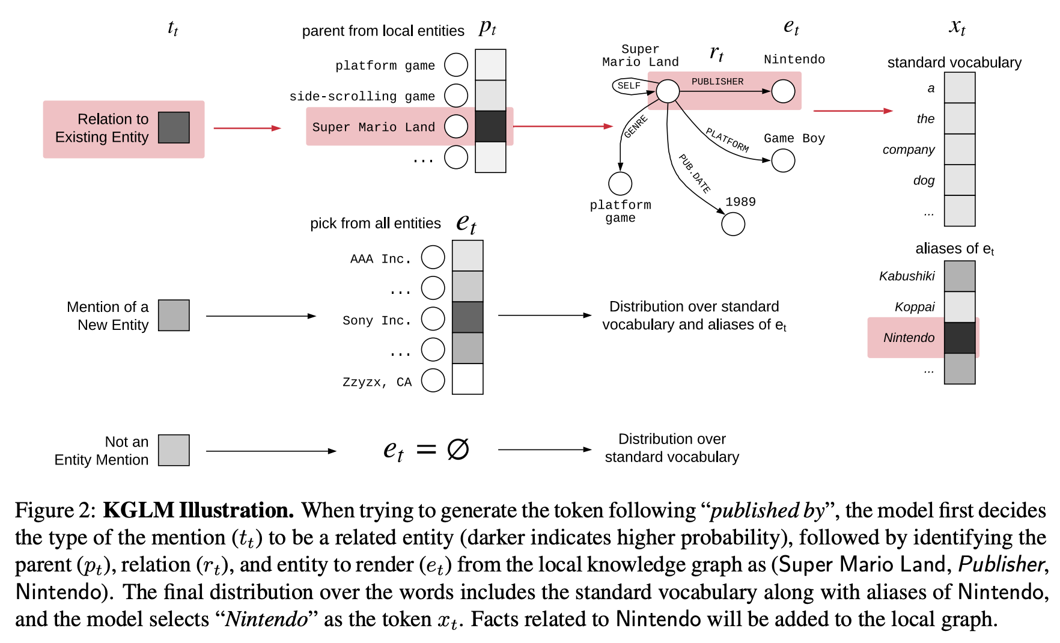
KGLM

Slide 27
KGLM
Outperforms GPT-2 and AWD-LSTM (some kind of regularized LSTM) on a fact completion task
Qualitatively, compare to GPT-2, KGLM tends to predict more specific tokens (GPT-2 predicts more popular, generic tokens)
Supports modifying/updating facts
Modifying the KG has a direct change in the predictions

Slide 28
Nearest Neighbor LM [Khandelwal et al., ICLR 2020]
Idea: learning the similarities between text sequences is easier than predicting the next word
Example: “Dickens is the author of _____” = “Dickens wrote ______”
So, store all representations of text sequences in a nearest neighbor datastore!
At inference:
Find the k most similar sequences of text in the datastore
Retrieve the corresponding values (i.e., the next word) for the k sequences
Combine the kNN probabilities and LM probabilities for the final prediction
Generalization through Memorization: Nearest Neighbor Language Models, Khandelwal et al., 2020, https://arxiv.org/pdf/1911.00172.pdf

Slide 29
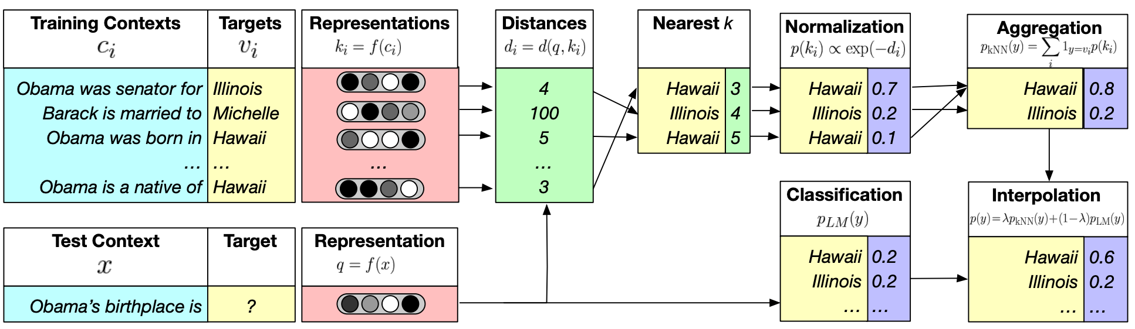
Nearest Neighbor LM
Note that f here is a transformer-based model, d here is simple L² distance

Slide 30
Method 3: Modify the training data
Previous methods incorporated knowledge explicitly through pretrained embeddings and/or an external memory
Question: Can knowledge also be incorporated implicitly through the unstructured text?
Answer: Yes! Mask or corrupt the data to introduce additional training tasks that require factual knowledge
Advantages:
No additional memory/computation requirements
No modification of the architecture required

Slide 31
Pretrained Encyclopedia: Weakly Supervised Knowledge-Pretrained Language Model (WKLM) [Xiong et al., ICLR 2020]
Key idea: train the model to distinguish between true and false knowledge
Replace mentions in the text with mentions that refer to different entities of the same type to create negative knowledge statements
Model predicts if entity has been replaced
Type-constraint is intended to enforce linguistically correct sentences
True knowledge statement: J.K.Rowling is the author of Harry Potter.
Negative knowledge statement: J.R.R. Tolkien is the author of Harry Potter
Pretrained Encyclopedia: Weakly Supervised Knowledge-Pretrained Language Model, Xiong et al., https://arxiv.org/pdf/1912.09637.pdf

Slide 32
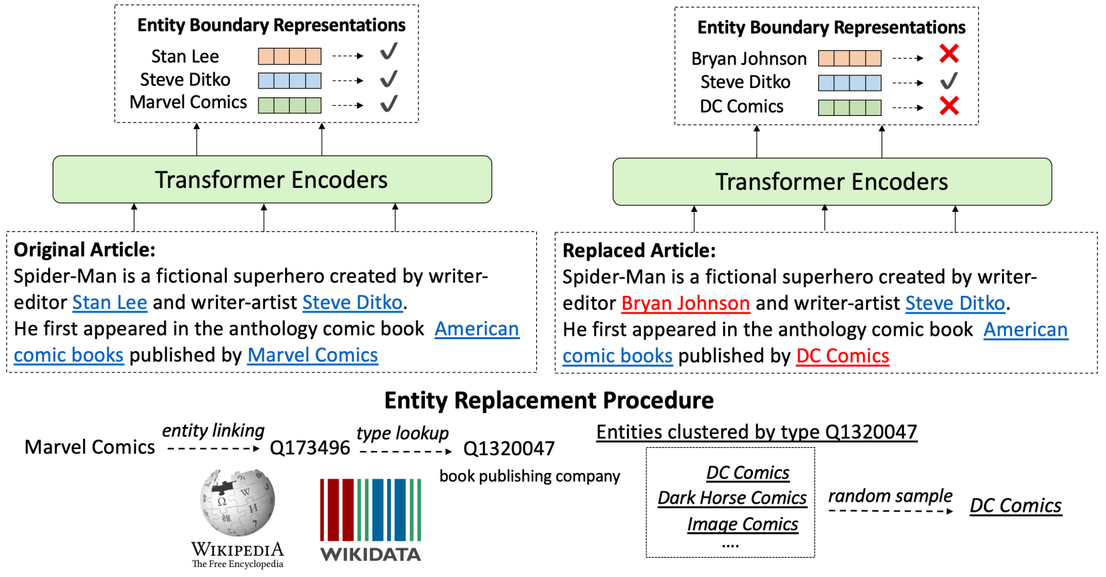
Pretrained Encyclopedia: Weakly Supervised Knowledge-Pretrained Language Model (WKLM) [Xiong et al., ICLR 2020]
Pretrained Encyclopedia: Weakly Supervised Knowledge-Pretrained Language Model, Xiong et al., https://arxiv.org/pdf/1912.09637.pdf

Slide 33
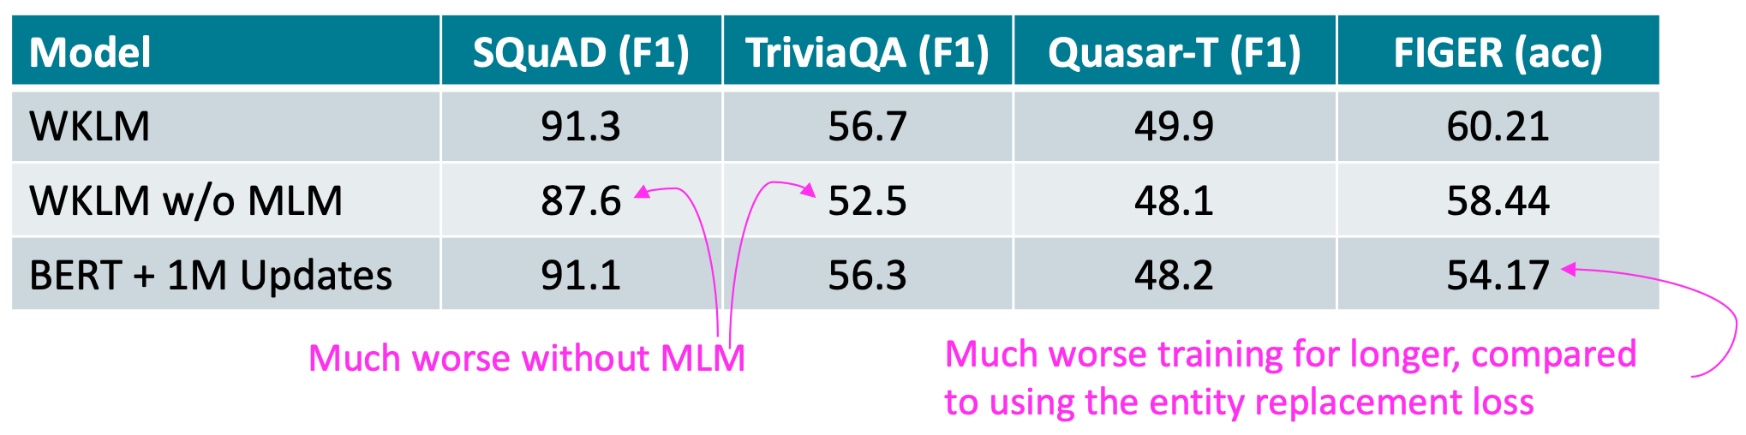
Pretrained Encyclopedia: Weakly Supervised Knowledge-Pretrained Language Model (WKLM)
Improved over BERT and GPT-2 in fact completion tasks
Improves over ERNIE on a downstream task (entity typing)
Ablation experiments (i.e., removing some components experiment)
MLM loss is essential for downstream task performance
WKLM outperforms training longer with just MLM loss

Slide 34
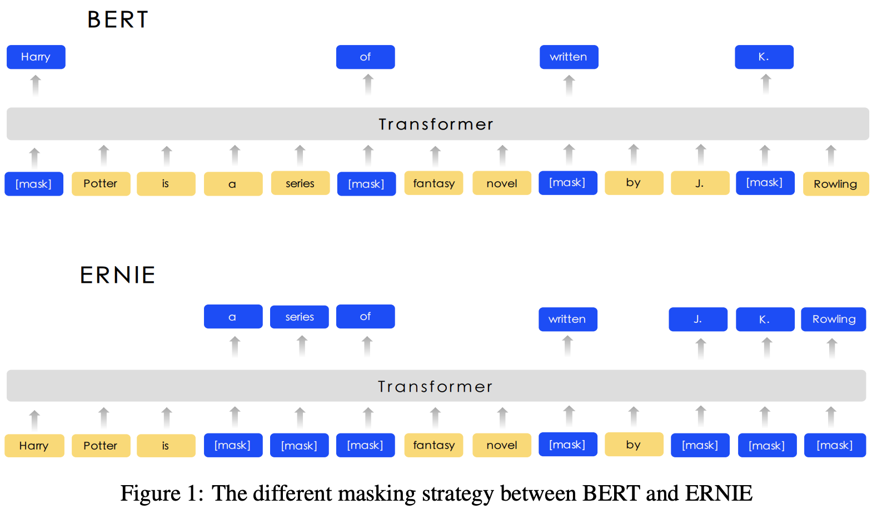
ERNIE: Enhanced Representation through Knowledge Integration [Sun et al., arXiv 2019] (another ERNIE paper)
ERNIE: Enhanced Representation through Knowledge Integration, Sun et al., https://arxiv.org/abs/1904.09223

Slide 35
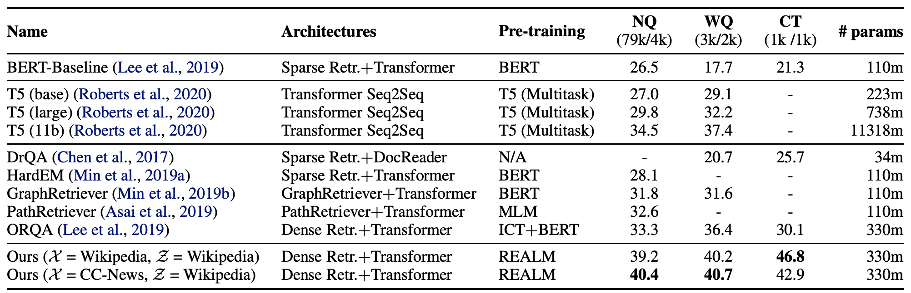
REALM: Retrieval-Augmented Language Model Pre-Training [Guu et al., ICML 2020]
Salient span masking - focus on examples that require world knowledge to predict the masked tokens (e.g., location, date)
REALM: Retrieval-Augmented Language Model Pre-Training, Guu et al., https://arxiv.org/pdf/2002.08909.pdf

Slide 36
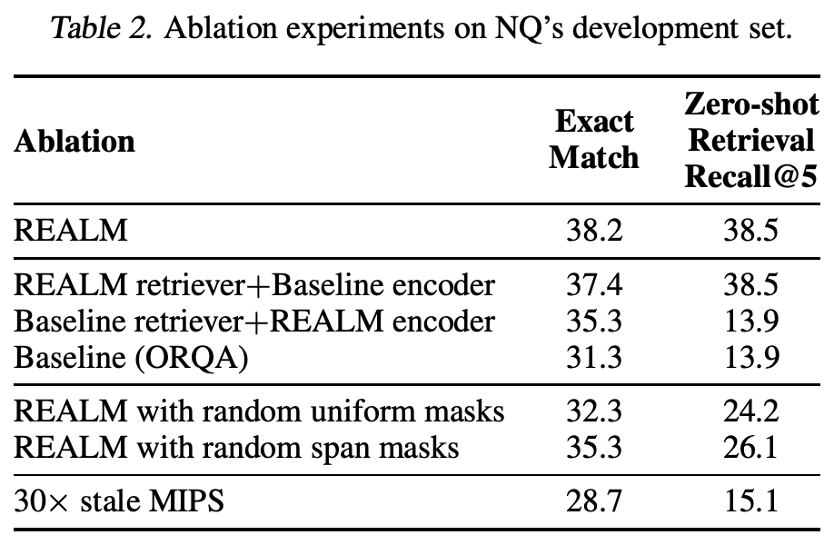
REALM: Retrieval-Augmented Language Model Pre-Training
Through the ablation experiments, it is clear that span salient masking creates a huge difference (REALM vs. REALM with random uniform masks vs. random span masks)

Slide 37
Evaluating knowledge in LMs

Slide 38
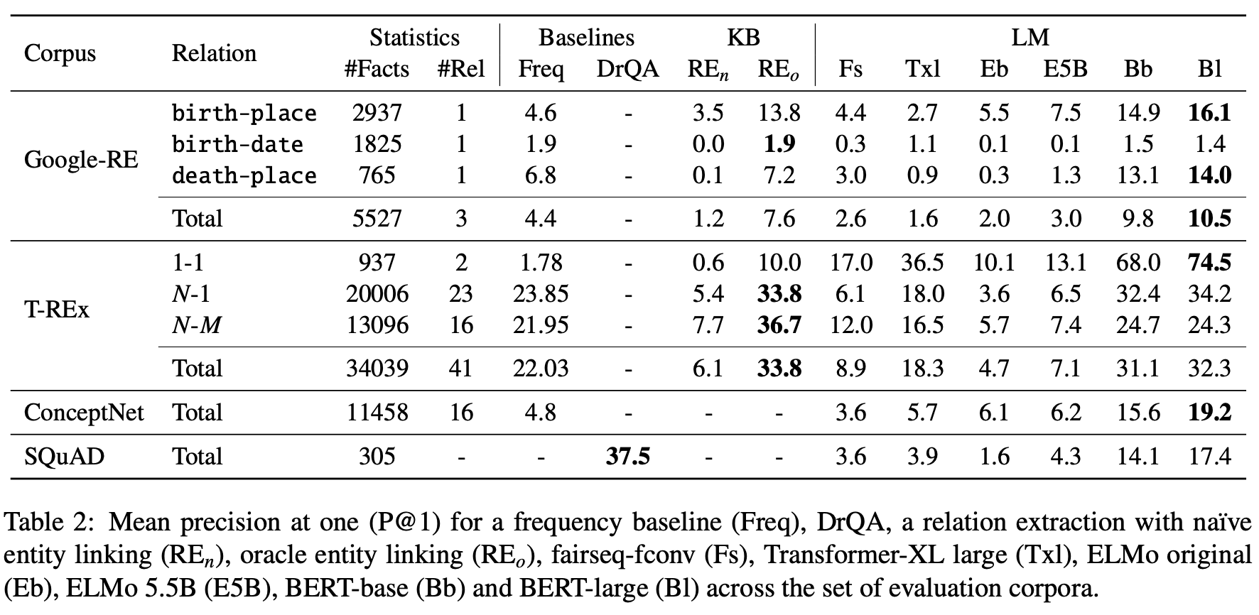
LAnguage Model Analysis (LAMA) Probe [Petroni et al., EMNLP 2019]
How much relational (commonsense and factual) knowledge is already in off-the-shelf language models without further fine-tuning.
Manually constructed a set of fill-in-the-blank statements
basically the same as salient span masking
Authors tested on using several datasets - Google-RE (60K facts from Wikipedia), T-REx (subset of Wikidata triples), ConceptNet (multilingual base), SQuAD (popular question answering dataset)
Language Models as Knowledge Bases? Petroni et al., 2019, https://aclanthology.org/D19-1250.pdf

Slide 39
LAnguage Model Analysis (LAMA) Probe
Limitations:
Hard to understand why models perform well when they do
BERT-large may be memorizing, NOT understanding / knowing!
LM is very sensitive to the phrasing of the statement
LAMA has only one manually defined templates for each relation
This means probe results are a lower bound on knowledge encoded in the LM
Solution: Remove examples from LAMA that can be answered without relational knowledge (e.g., “Pope Francis is a pope”) [Poerner et al., EMNLP 2020) - (a.k.a LAMA-UHN)
Knowledge-enhanced model score drops only <1%
BERT’s score drops even more (8%) with LAMA-UHN

Slide 40
Knowledge-driven downstream tasks [Peters et al., ACL 2019]
The previous method (e.g., LAMA) is very intrinsic, we can also look at more extrinsic evaluation….
Measures how well the knowledge-enhanced LM transfer its knowledge to downstream tasks
The bad news is that unlike probes, this evaluation usually requires finetuning the LM on downstream tasks.
Common tasks for assessing knowledge:
Relation extraction
Example: [Bill Gates] was born in [Seattle]; label: city of birth
Entity typing
Example: [Alice] robbed the bank; label: criminal
Question answering
Example: “What kind of forest is the Amazon?”; label: “moist broadleaf forest”
Knowledge Enhanced Contextual Word Representations, Peters et al. 2019, https://aclanthology.org/D19-1005.pdf

Slide 41
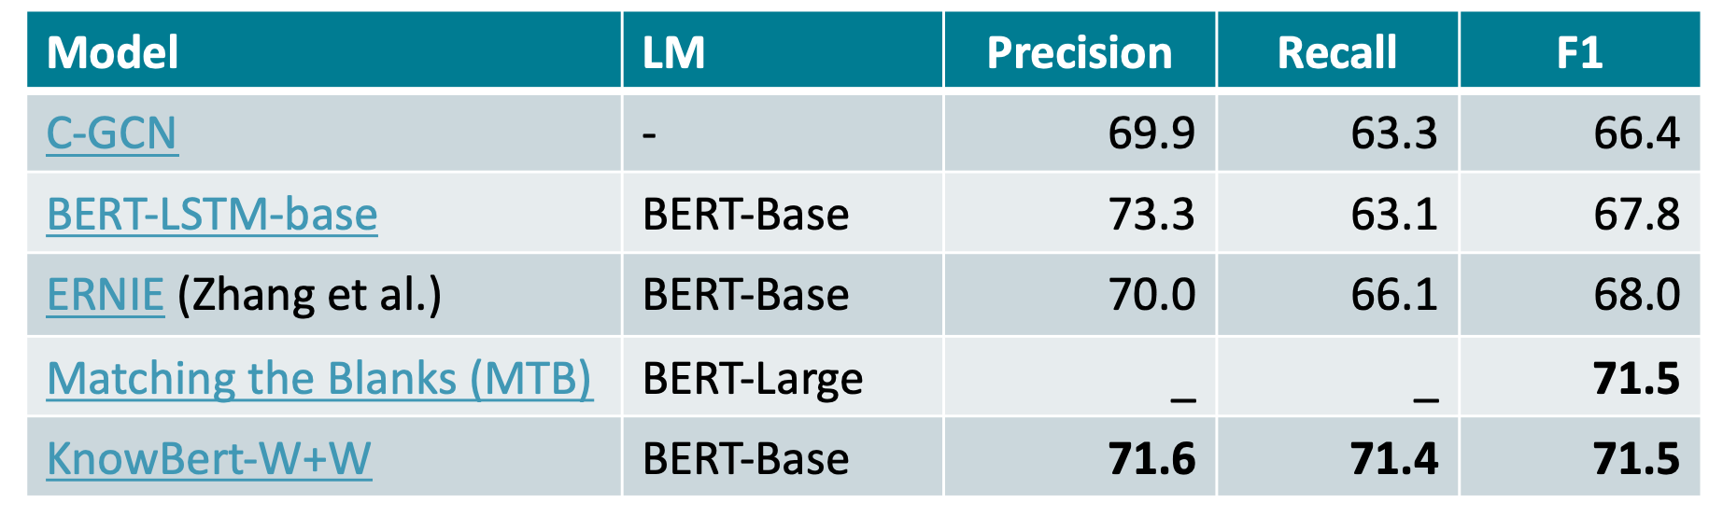
Knowledge-driven downstream tasks
Results on testing some models on relation extraction

Slide 42
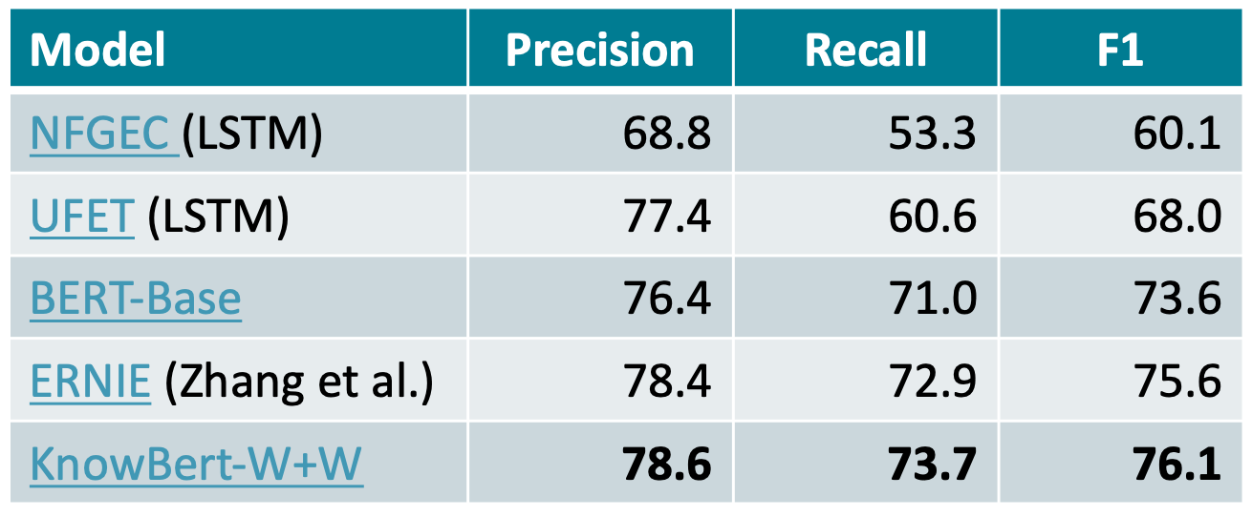
Knowledge-driven downstream tasks
Results on testing some models on entity typing
Impressively, NFGEC and UFET were specifically designed for entity typing

Slide 43
Summary
Use pretrained entity embeddings
Often not too difficult to apply
Often requires extra pretraining…
Indirect way of incorporating knowledge and can be hard to interpret
Add an external memory
Can support some updating of factual knowledge and easier to interpret
Tend to be more computationally expensive
Modify the training data
Requires no model changes or additional computation. Easiest to analyze. Active area of research.
Still questioning whether the model is memorizing vs. knowing….
Evaluation
Still questioning a “good” benchmark for assessing knowledge
There are many more papers I haven’t covered….so keep an eye out for all these updates!

Slide 44
Still more!
Yet another entity embedding for knowledge - E-BERT
Poerner et al., EMNLP 2020
Retrieval-augmented language models
REALM, Guu et al., ICML 2020
Modifying knowledge in language models
Modifying Memories in Transformer Models, Zhu et al., arXiv 2020
More multitask pre-training for language models
KEPLER, Wang et al., TACL 2020
More efficient knowledge systems
NeurIPS Efficient QA challenge
Better knowledge benchmarks
KILT, Petroni et al., arXiv 2020

